Slide 1
Tips for Online Searching 2020-2021
School librarian
Mr. Isaac lai
General tips
Global Issue, Jstor, Opposing View Points,Questia, WiseSearch
Notes:
General searching tips, School Databases, Citation instructions

Slide 2
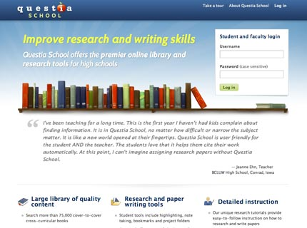
Library Databases
Global Issue in Context
Opposing View Points
National Geographic
GVRL
Questia School
Jstor (Campus use only)

Slide 3
Play with the Databases, Not that hard! Save Time! Good results!

Slide 4
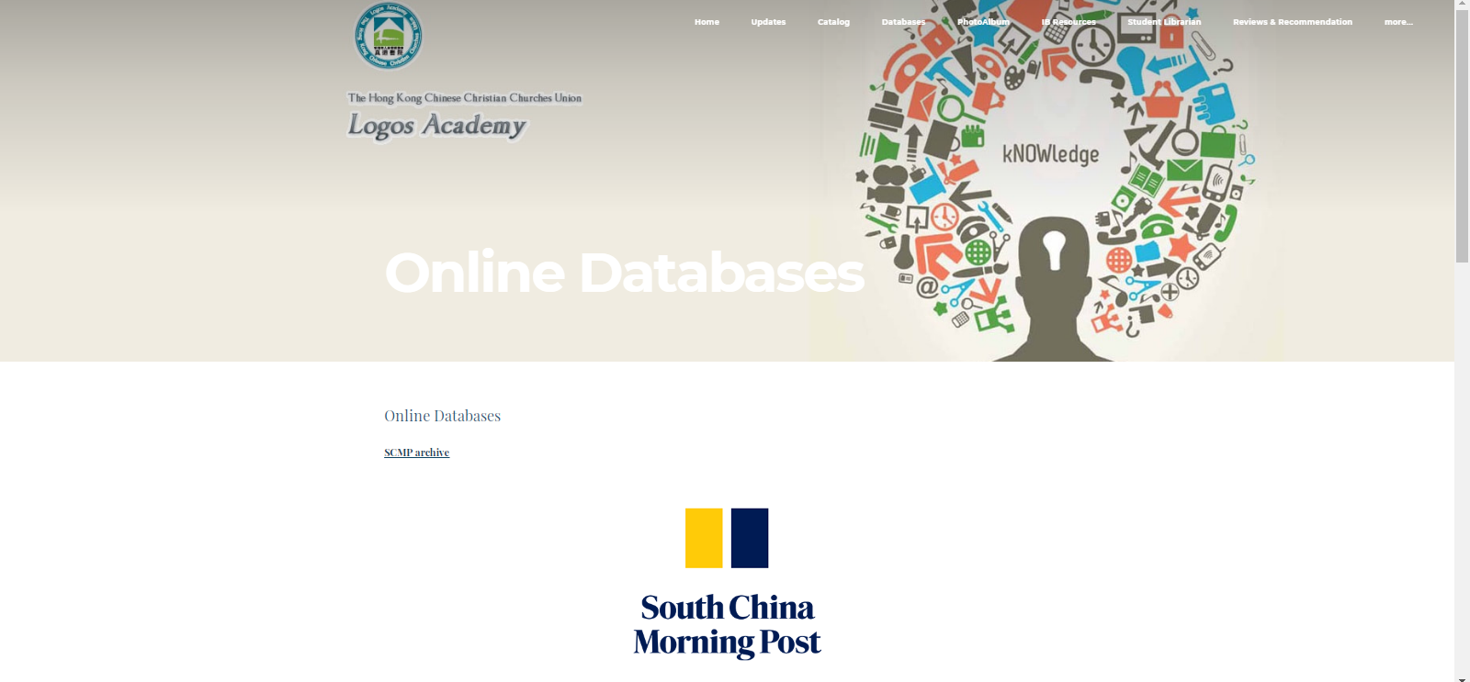
Logos Library Website
http://logosacademylibrary.weebly.com/secondary---2001323416.html

Slide 5
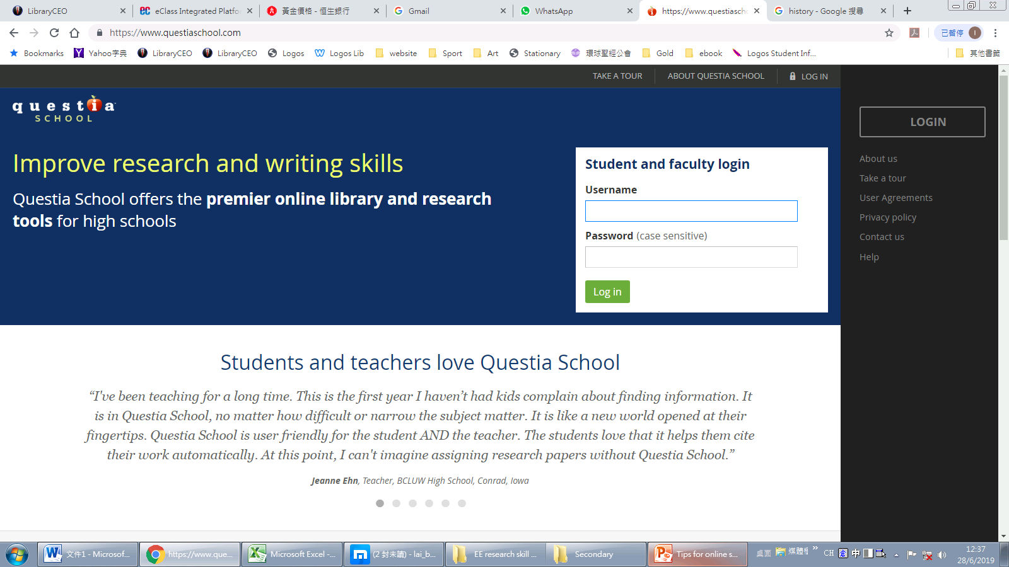
Questia School
Login: sXXXXXXX@logosacademy.edu.hk
PW: student

Slide 6
Global Issues
Opposing Viewpoints
National Geographic Virtual Library
Gale Virtual Reference Library (ebook)
PW: Focus

Slide 7
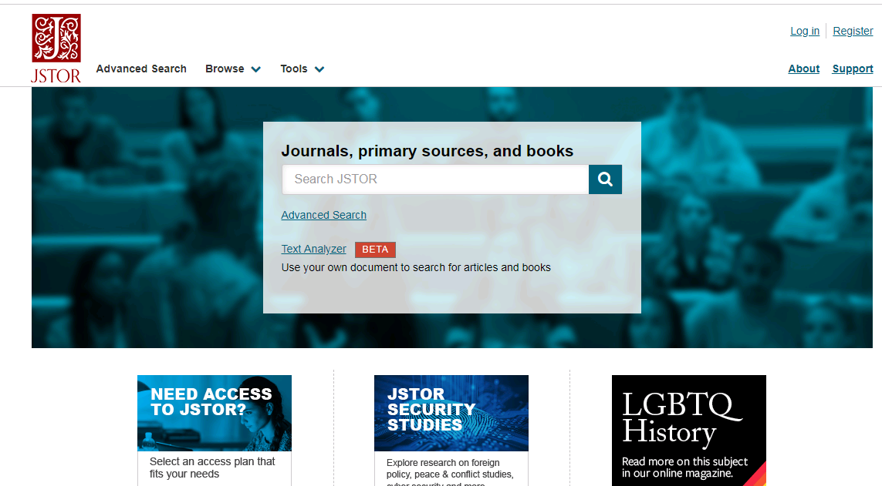
Jstor
Disadvantage: Results including other language
Campus Used Only

Slide 8
Narrow your search
Be specific
6303 results related to "Iraq“
623 results related to "Iraq war“
12 results related to "Iraq war probe"

Slide 9
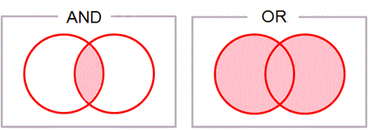
Narrow your search
“Or” “AND”
it will increase the number of documents that are found use it when you short on results
example:
Racism Global Viewpoints 5,927 Reference 879
Prejudice Global Viewpoints 2,685 Reference 124
racism OR prejudice Global Viewpoints 12,912 Reference 1,034
racism AND prejudice Global Viewpoints 564 Reference 66

Slide 10
Narrow your search
“Or” “AND”
it will increase the number of documents that are found use it when you short on results
example:
Hong Kong Global Issues 5,284 results
Trade War Global Issues 20,383 results
Hong Kong AND Trade War Global Issues 992
Hong Kong AND Trade War AND Price Global Issues 50 results

Slide 11
Narrow your search
Search keyword:
Hong Kong
Search results:
5,031+210+33+10……
Search keyword: Hong Kong AND trade war
Search results:
25+1+50+893

Slide 12
Narrow your search
Search keyword: Hong Kong AND trade war AND price
Search results:
1+1+47 (news)
Search keyword: Hong Kong AND trade war AND price after 2018
Search results:
1+1+29 (news)

Slide 13
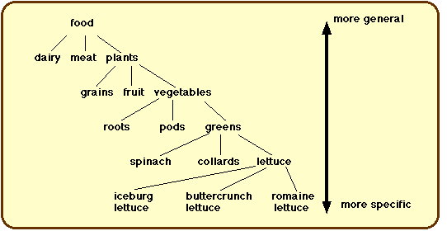
Find your Topic
General
Specific
Subject Areas
Subjects
Topic Areas
Specific Topics
Art
Science
Social Studies
Painting
Biology
Geography
Modern Artists
Sea Creatures
Pacific Rim
Picasso
Otters
Hong Kong

Slide 14
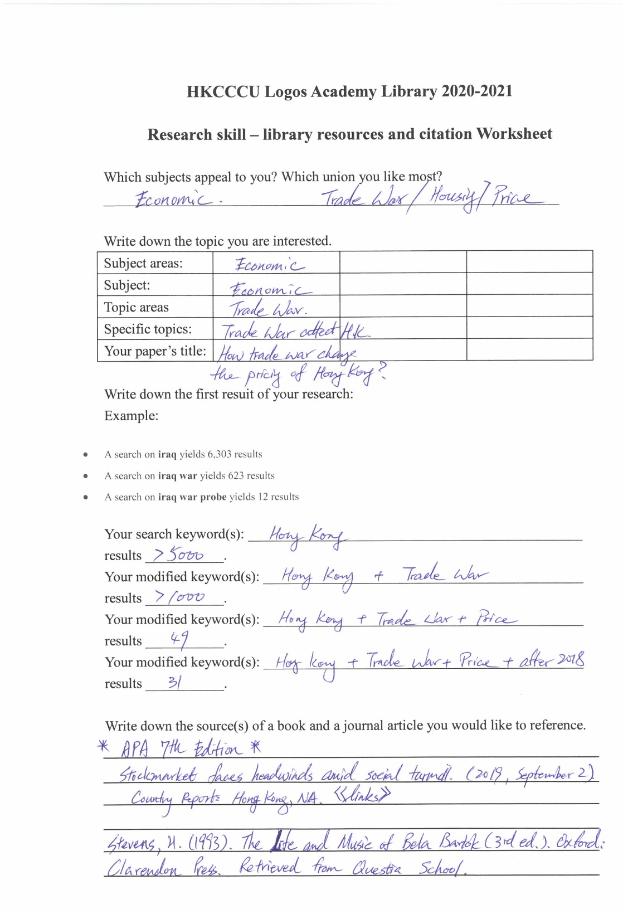
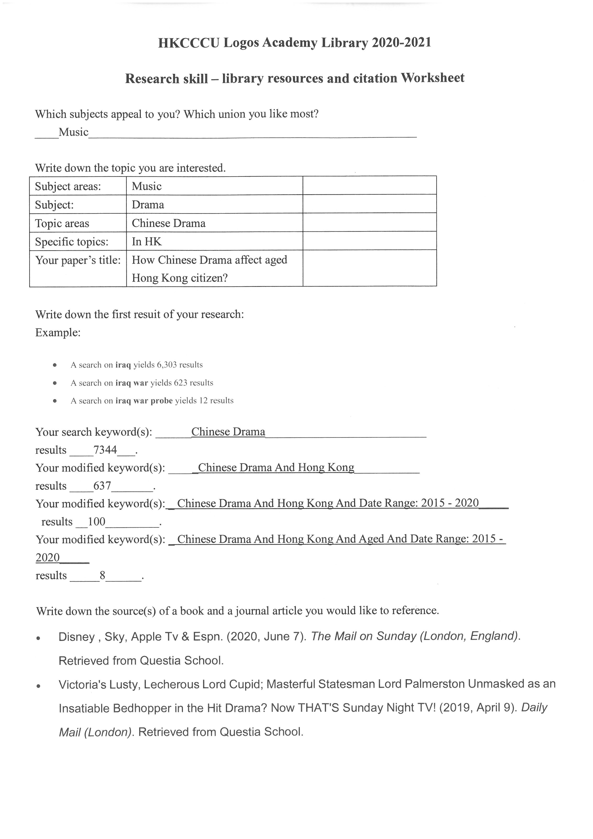

Slide 15
APA
You Must Know

Slide 16
Books
Italic

Slide 17
Books
Book with two or more authors :
In Reference List
Krause, K. L., Bob, S., & John, S. (2006). Educational psychology for learning and teaching (2nd ed.). South Melbourne, Vic., Australia: Thomson.
In-text citation
(Krause et al., 2006, p.26)
Italic

Slide 18
Journal
Italic

Slide 19
Online Sources

Slide 20
Online Sources
Webpages are referenced, reference the homepage
In Reference List
Statistics New Zealand. (2007). New Zealand in profile 2007. Retrieved from http://www.stats.govt.nz
In-text citation
(Statistics New Zealand, 2007)

Slide 21
Ask Librarian email: laich@logosacademy.edu.hk

